Slide 1




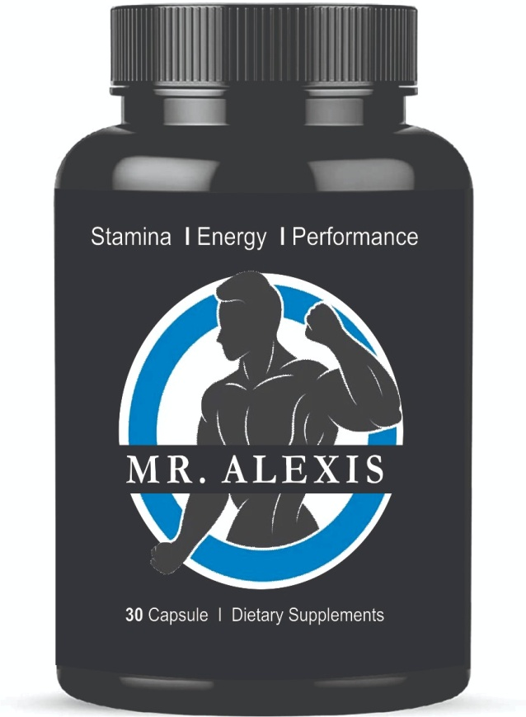




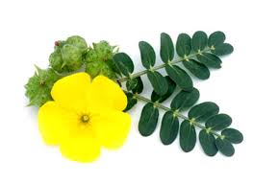
MR. ALEXIS
Clinically tested
Safe for long-term use
Highly effective herbs
Zero Side
Effects
100% Natural
100% Ayurvedic

Slide 2
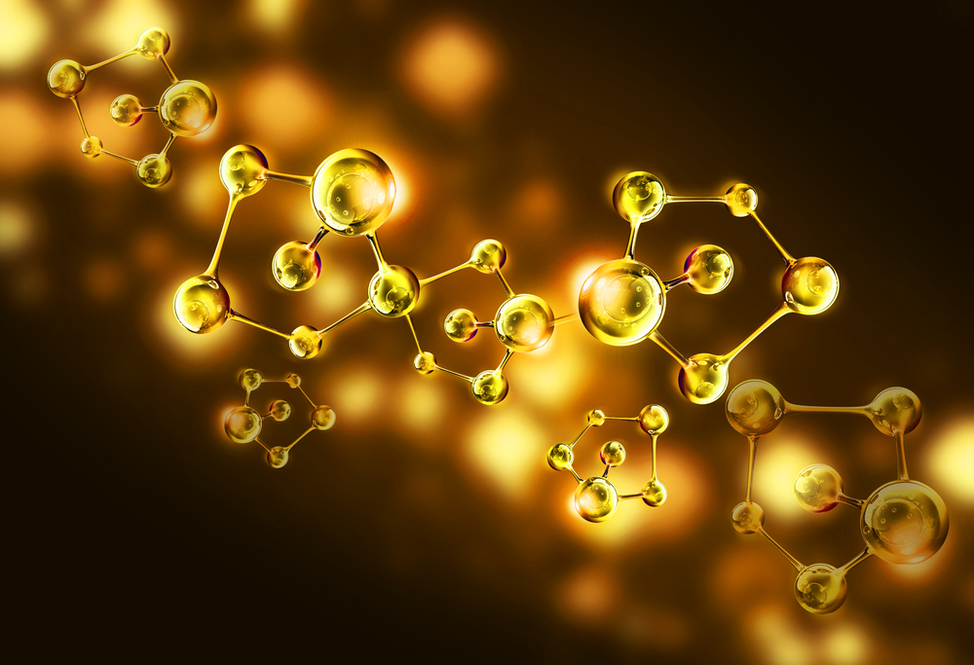
MR. ALEXIS Prepare by using Nanotechnology
A2 Gir Cow Ghee mix with herbal extract by Neno-tech process that reduce molecule size enhance penetration so maximum reach at cellular level.

Slide 3
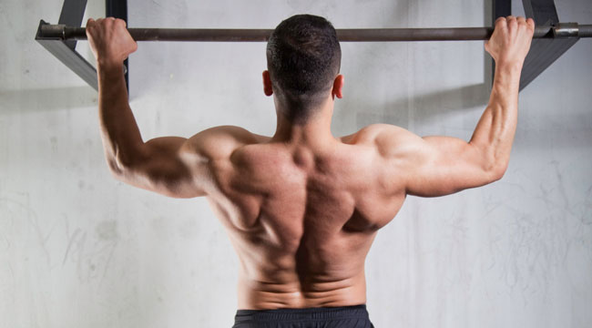

MR. ALEXIS For Stamina & Strength
Give you more energy so you can work out more time and effectively

Slide 4
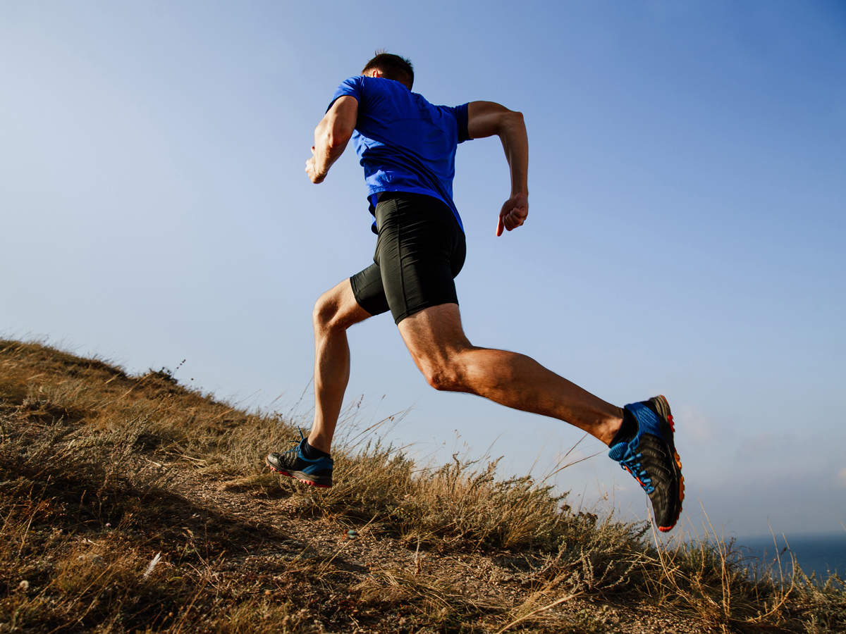

MR. ALEXIS - Energy Booster
Increases blood oxygen carrying capacity so increases more energy production

Slide 5

MR. ALEXIS Enhance Sexual Desire & Performance
1. Correct Premature ejaculation
2. Regain the lost vitality
3. Improves fearlessness
4. Boost longer and harder erection
5. Increase muscle mass
6. Builds male stamina and improves energy levels
7. Enhances physical strengths and vigour
8. Helps manage stress and anxiety
9. Improves testosterone levels and improves performance
10. Reduces physical and psychological fatigue
11. Rejuvenates and energizes the body and mind
Make you Longer, Bigger, Thicker and Harder erection

Slide 6
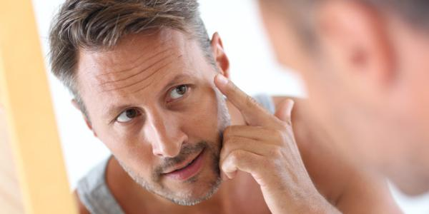
MR. Alexis Best anti-aging
Remove Fine lines,
Wrinkles appear on skin,
Restore & rejuvenate, give you a young look
Make your skin young again

Slide 7
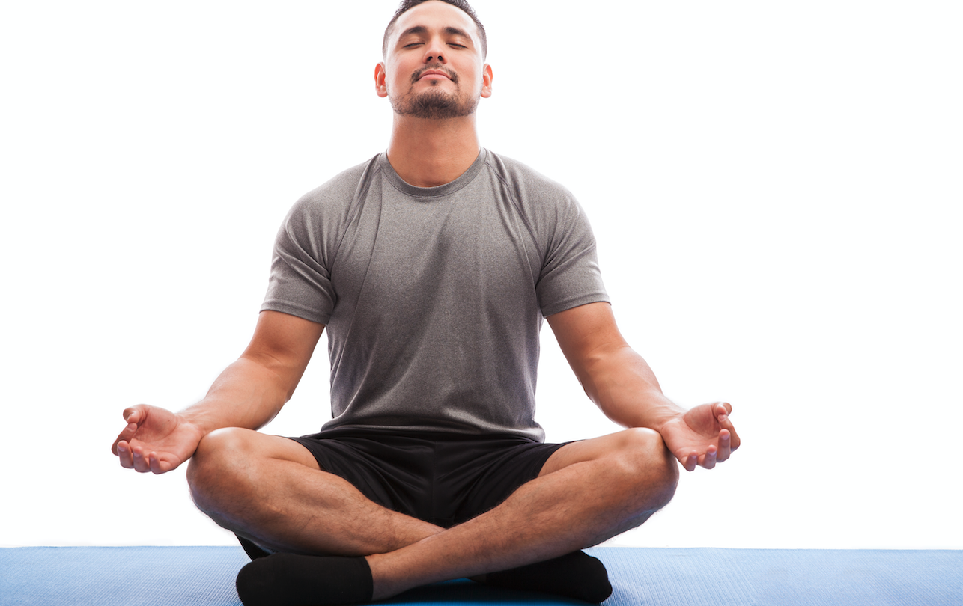
MR. ALEXIS – Anti Stress
Give strength to your brain neuron

Slide 8

MR. ALEXIS
Best for Diabetes Patients
Give Strength, Energy & Performance

Slide 9
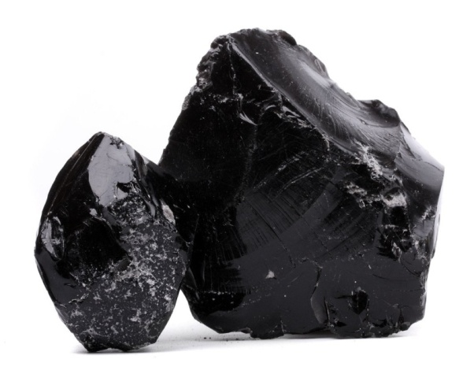
SHILAJIT
Increases Testosterone
It stimulates the secretion of testosterone which improves blood flow in the whole body organ. It helps to increase male power, maintain erection, and enhance vigor and vitality.

Slide 10
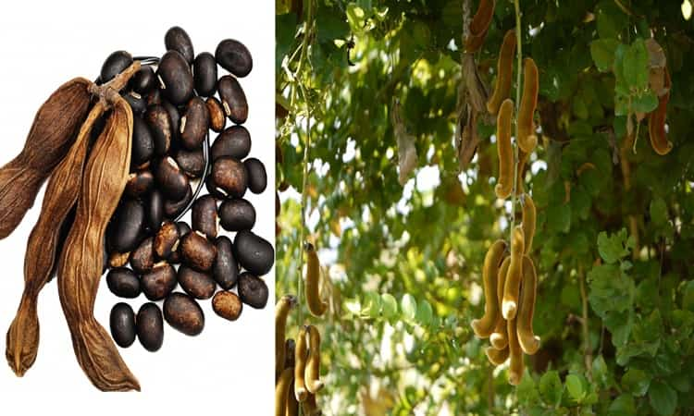
KAUNCH BEEJ
Improve Sex Desire
It works as an aphrodisiac and helps in increasing desire. It also helps to increase the production and quantity of sperm counts.

Slide 11
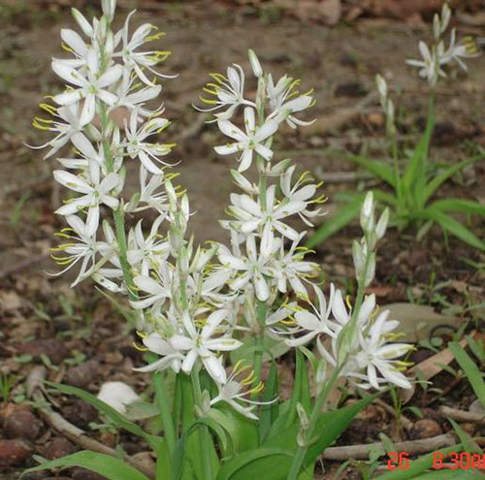
SAFED MUSHALI
Improve Time & Performance
It is a great testo booster herb also known as natural viagra. Safed Musli is considered the most important remedy for PE and ED in men.

Slide 12
GOKSHURA
Improve Body Strength & Stamina
Gokshura is beneficial in erectile dysfunction as it strengthens the penile tissue.

Slide 13
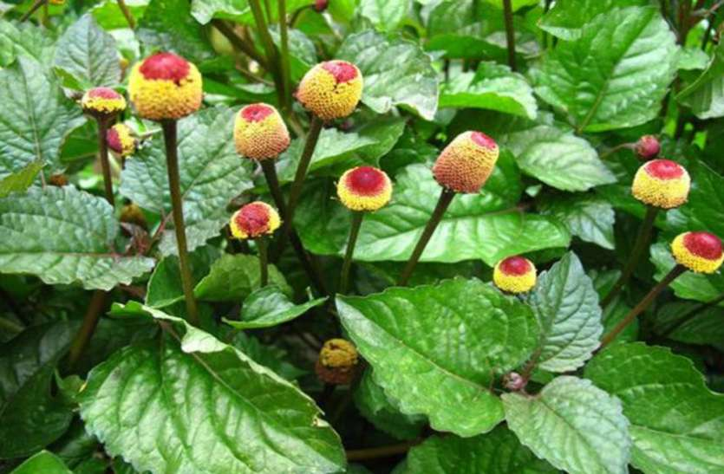
AKARKARA
Increase Sperm Count
Akarkara helps to increases Sperm count quality , and motility

Slide 14
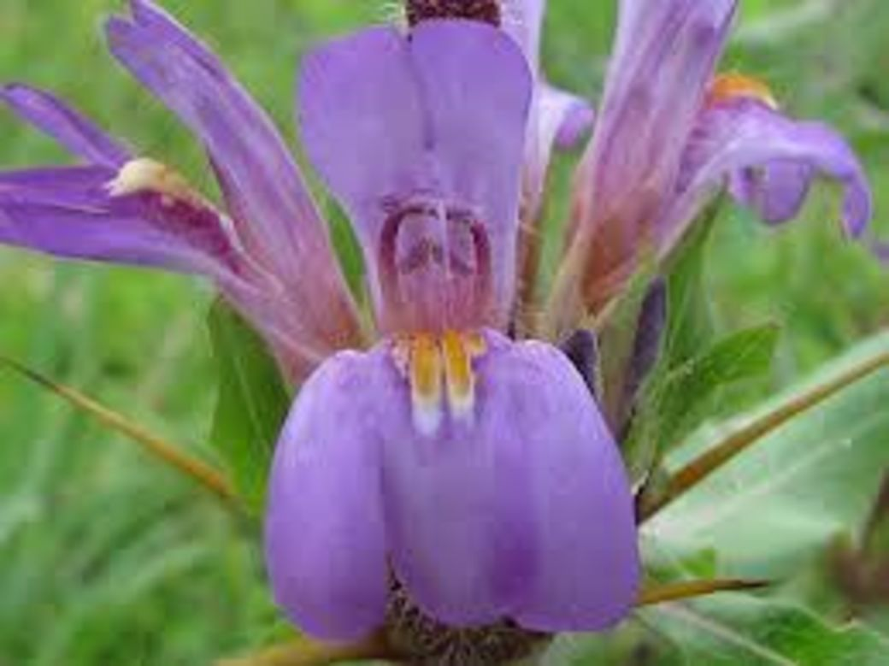
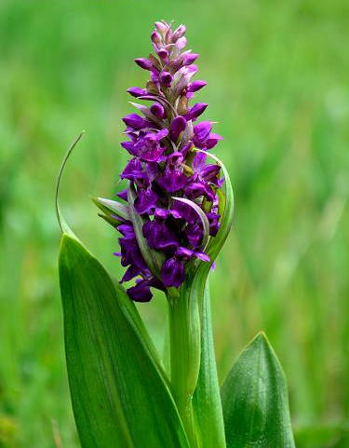
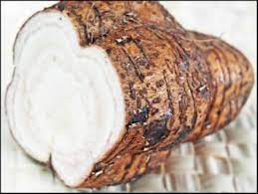
Secret & Potent Herbs
For High Strength & Stamina
Salampanja, Vidari kand, Kokilakasha and Other herbs
Makes MR. ALEXIS a best Product for Men’s Health

Slide 15
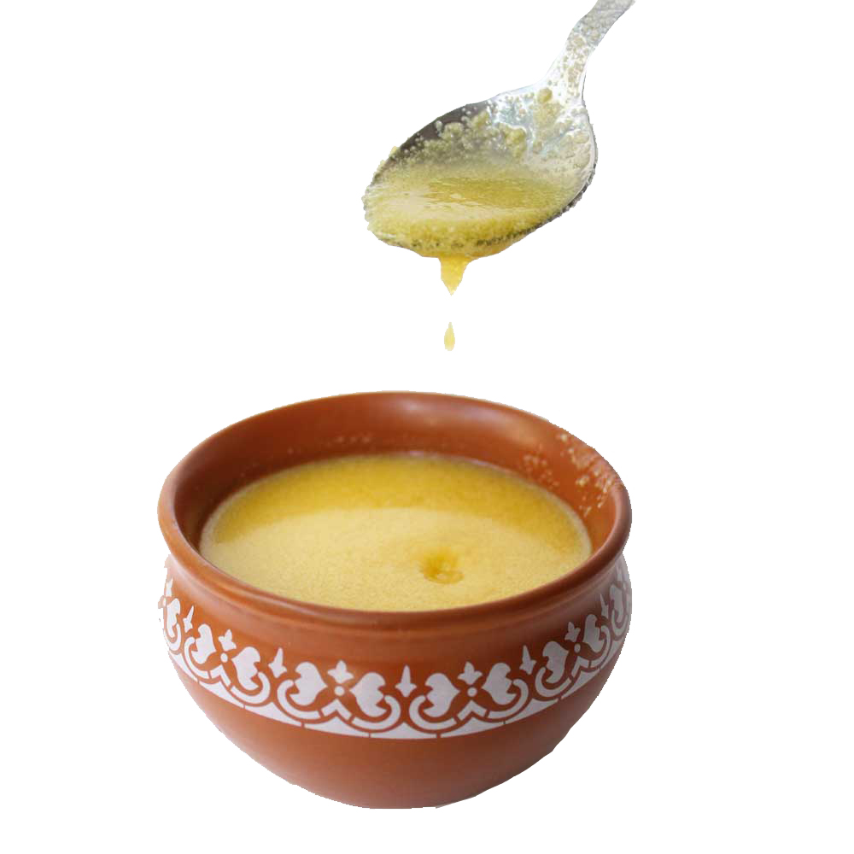
A2 Cow Ghee
Increase Penetration & Muscle Strength
All Herbal extract process in Bhavana Dravya A2 Cow Ghee

Slide 16
MR. ALEXIS Stamina I Energy I Performance
Safe for long-term use
100% Ayurvedic
Clinically tested
For Improve Your Time & Performance
1 Capsule with milk one hour before sleep daily
For Best Result use regularly 3 months

